Slide 1
Perceptrons, SVMs, and Friends:
Some Discriminative Models for Classification

Slide 2
The Automatic Classification Problem
Assign object/event or sequence of objects/events
to one of a given finite set of categories.
· Fraud detection for credit card transactions, telephone calls, etc.
· Worm detection in network packets
· Spam filtering in email
· Recommending articles , books, movies, music
· Medical diagnosis
· Speech recognition
· OCR of handwritten letters
· Recognition of specific astronomical images
· Recognition of specific DNA sequences
· Financial investment
Machine Learning methods provide one set of
approaches to this problem

Slide 3
The Automatic Classification Problem
Assign object/event or sequence of objects/events
to one of a given finite set of categories.
· Fraud detection for credit card transactions, telephone calls, etc.
· Worm detection in network packets
· Spam filtering in email
· Recommending articles , books, movies, music
· Medical diagnosis
· Speech recognition
· OCR of handwritten letters
· Recognition of specific astronomical images
· Recognition of specific DNA sequences
· Financial investment
Machine Learning methods provide one set of
approaches to this problem

Slide 4
The Automatic Classification Problem
Assign object/event or sequence of objects/events
to one of a given finite set of categories.
· Fraud detection for credit card transactions, telephone calls, etc.
· Worm detection in network packets
· Spam filtering in email
· Recommending articles , books, movies, music
· Medical diagnosis
· Speech recognition
· OCR of handwritten letters
· Recognition of specific astronomical images
· Recognition of specific DNA sequences
· Financial investment
Machine Learning methods provide one set of
approaches to this problem

Slide 5
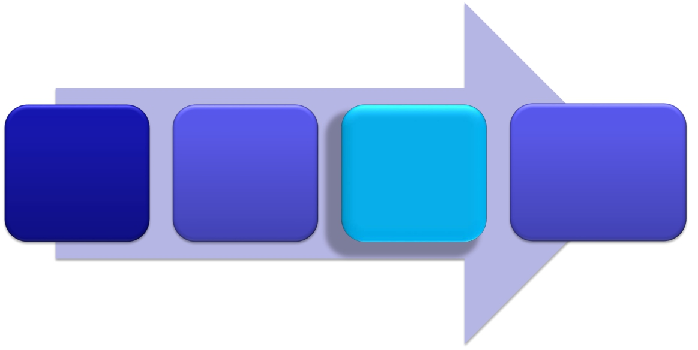
Universal Machine Learning Diagram
Things to
be
classified
Feature
Vector
Representation
Magic
Classifier
Box
Classification
Decision

Slide 6
Universal Machine Learning Diagram
Things to
be
classified
Feature
Vector
Representation
Magic
Classifier
Box
Classification
Decision

Slide 7
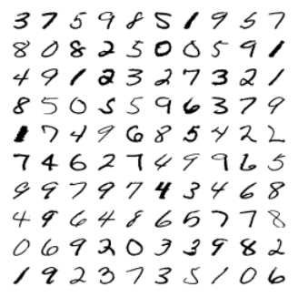
Example: handwritten digit recognition
Machine learning algorithms that
Automatically cluster these images
Use a training set of labeled images to learn to classify new images
Discover how to account for variability in writing style

Slide 8
Example: handwritten digit recognition
Machine learning algorithms that
Automatically cluster these images
Use a training set of labeled images to learn to classify new images
Discover how to account for variability in writing style

Slide 9
Example: handwritten digit recognition
Machine learning algorithms that
Automatically cluster these images
Use a training set of labeled images to learn to classify new images
Discover how to account for variability in writing style

Slide 10
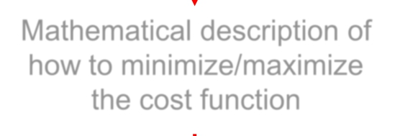
A machine learning algorithm
development pipeline: minimization
Problem statement
Mathematical description of
a cost function
Mathematical description of
how to minimize/maximize
the cost function
Implementation

Slide 11
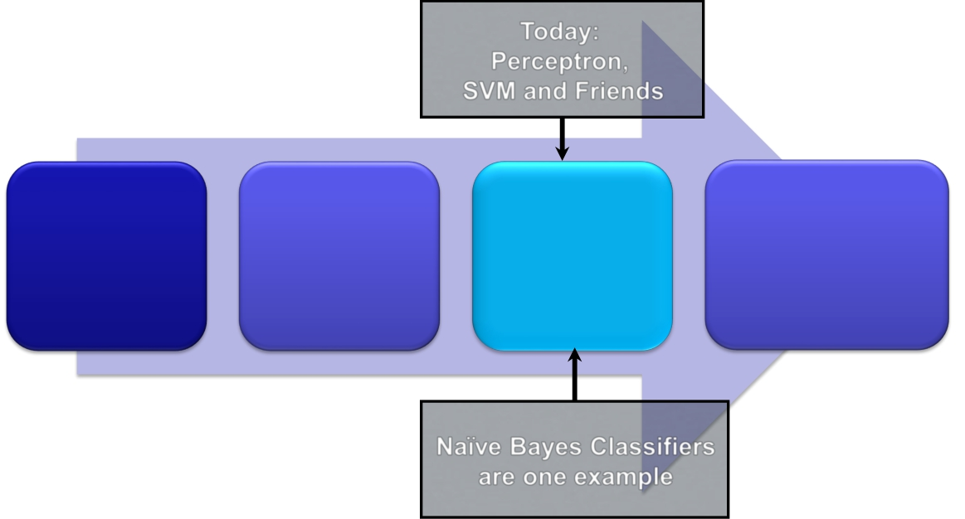
Universal Machine Learning Diagram
Today: Perceptron SVM& Friends
Things to
be
classified
Feature
Vector
Representation
Magic
Classifier
Box
Classification
Decision
NB & LR

Slide 12
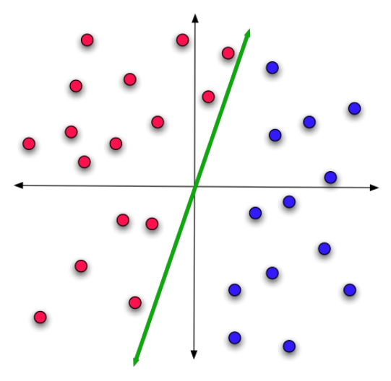
Linear Classification: Informal…
Find a (line, plane, hyperplane )
that divides the red points from
the blue points….

Slide 13
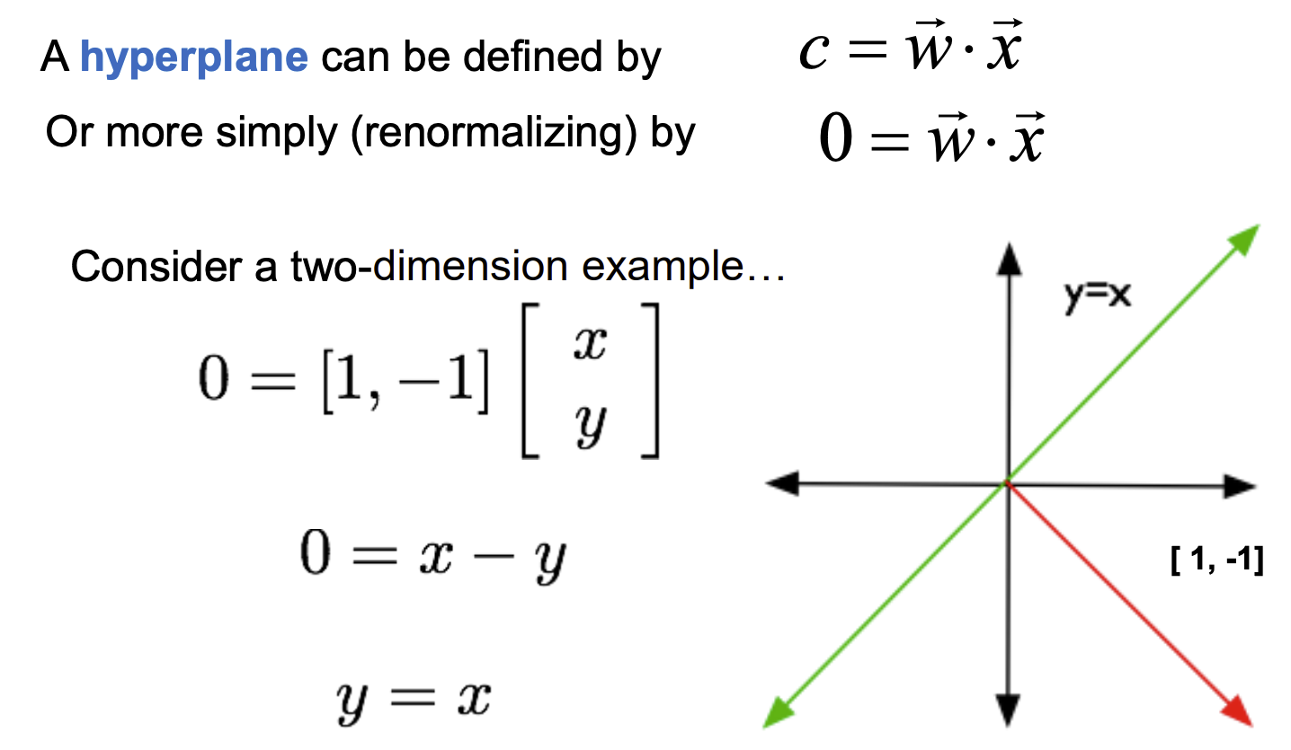
Hyperplane

Slide 14
Hyperplane

Slide 15
Hyperplane

Slide 16
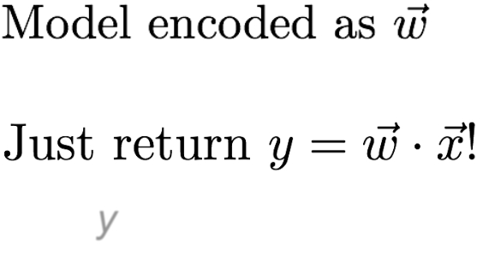
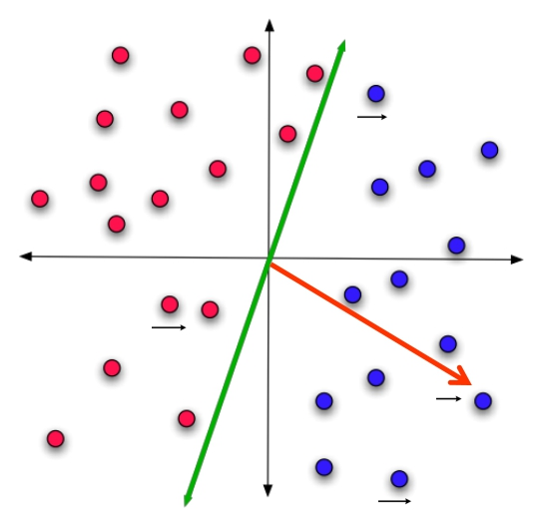
Linear Classification: Slightly more formal
x1
sign(y) tell us the class:
+ - blue
- - red
x2
(All vectors normalized to w
length 1, for simplicity) x3

Slide 17
Linear Classification: Slightly more formal
x1
sign(y) tell us the class:
+ - blue
- - red
x2
(All vectors normalized to w
length 1, for simplicity) x3

Slide 18
Linear Classification: Slightly more formal
x1
sign(y) tell us the class:
+ - blue
- - red
x2
(All vectors normalized to w
length 1, for simplicity) x3

Slide 19
Linear Classification: Slightly more formal
x1
sign(y) tell us the class:
+ - blue
- - red
x2
(All vectors normalized to w
length 1, for simplicity) x3

Slide 20
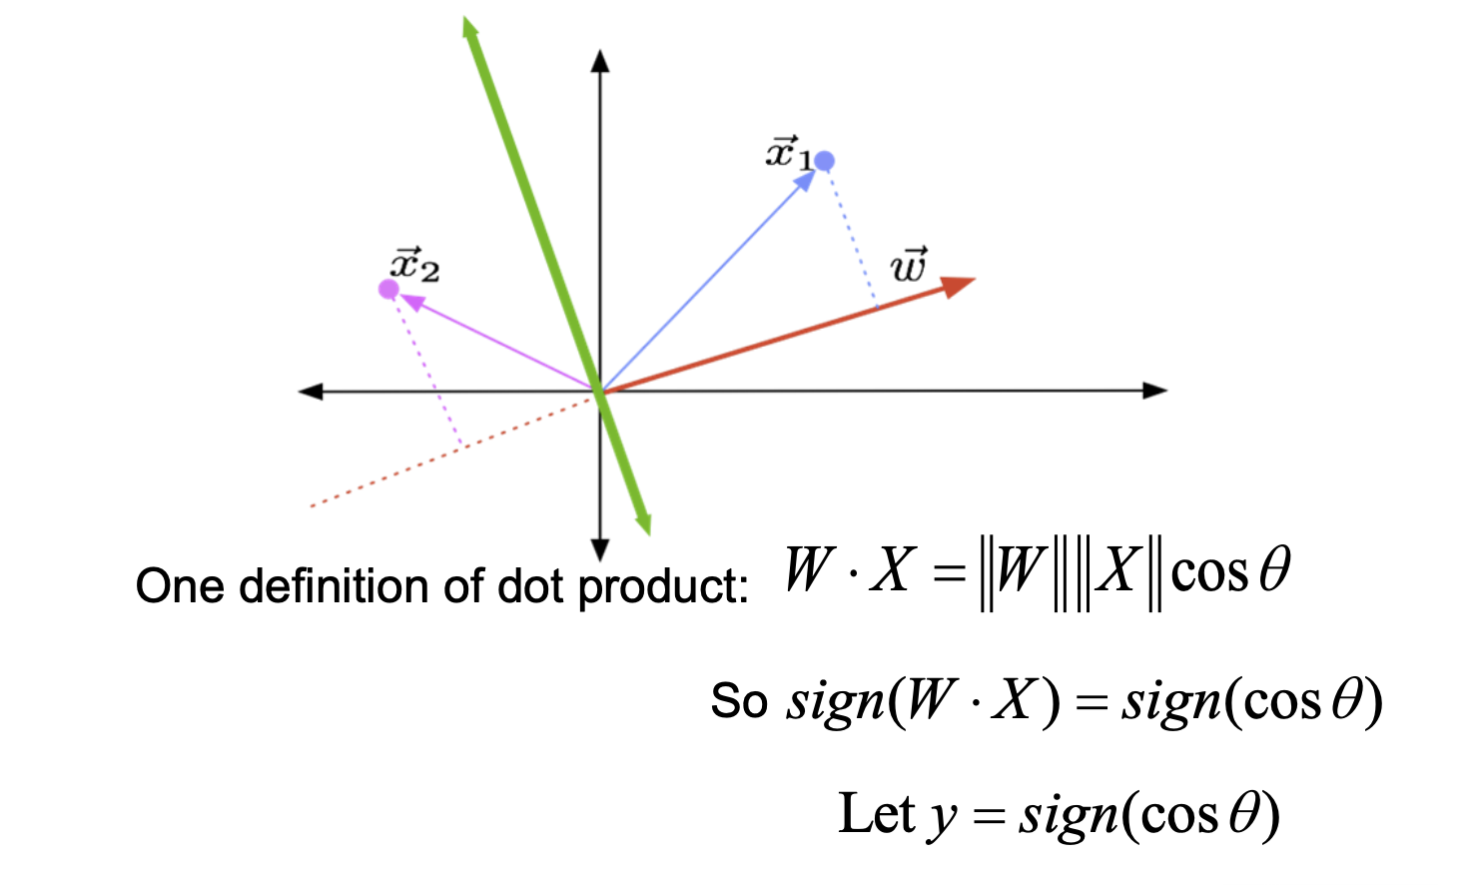
Computing the sign…

Slide 21
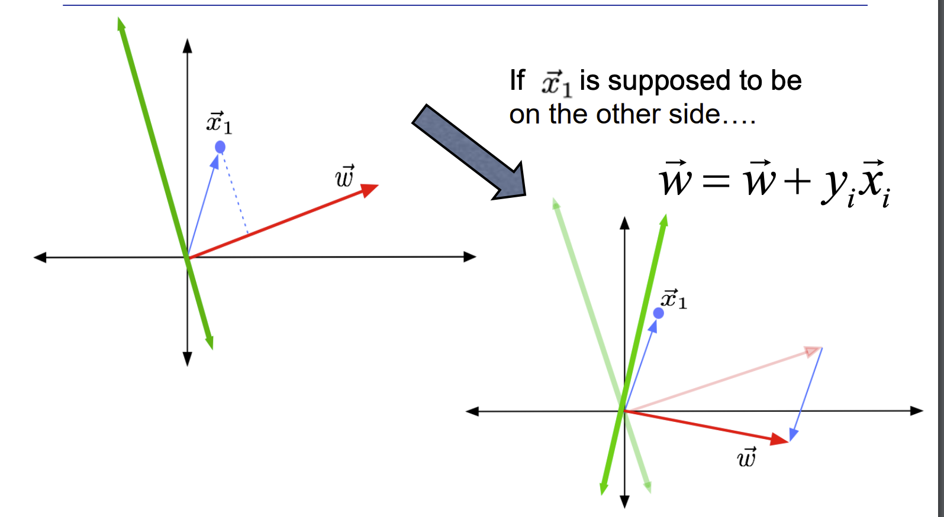
Perceptron Update Example

Slide 22
Perceptron Update Example

Slide 23
Perceptron Update Example

Slide 24
Perceptron Update Example

Slide 25
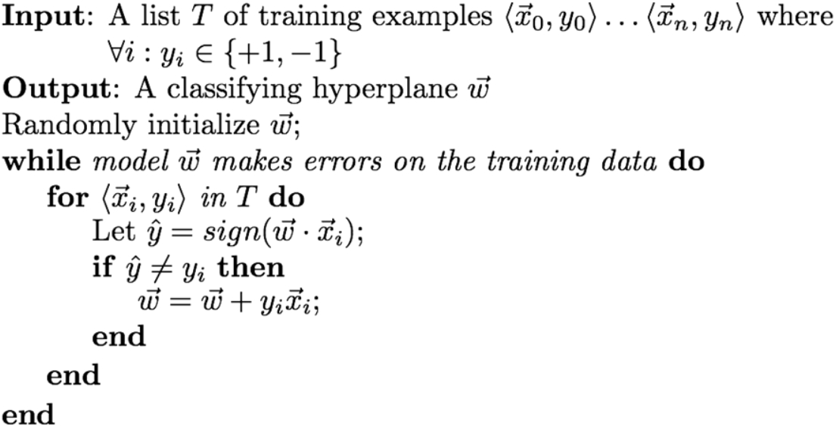
Perceptron Learning Algorithm
Converges if the training set is
linearly separable
May not converge if the training
set is not linearly separable

Slide 26
Perceptron Learning Algorithm
Converges if the training set is
linearly separable
May not converge if the training
set is not linearly separable

Slide 27
Perceptron Learning Algorithm
Converges if the training set is
linearly separable
May not converge if the training
set is not linearly separable

Slide 28
Perceptron Learning Algorithm
Converges if the training set is
linearly separable
May not converge if the training
set is not linearly separable

Slide 29
Perceptron Learning Algorithm
Converges if the training set is
linearly separable
May not converge if the training
set is not linearly separable

Slide 30
Support vector machines

Slide 31
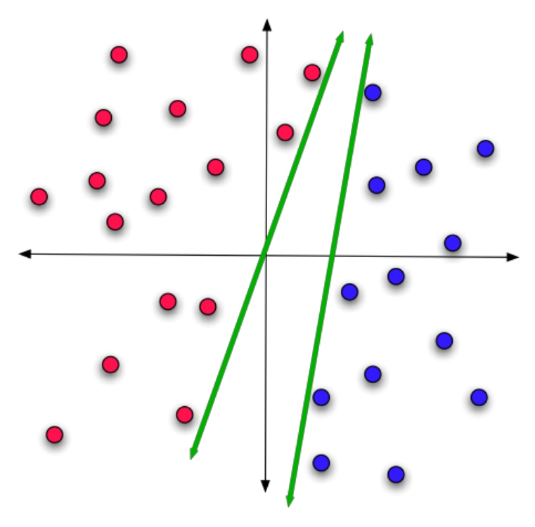
What’s wrong with these hyperplanes?

Slide 32
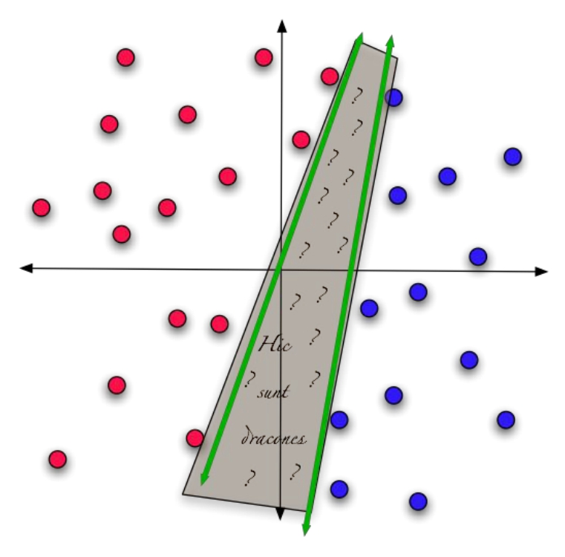
They’re unjustifiably biased!

Slide 33
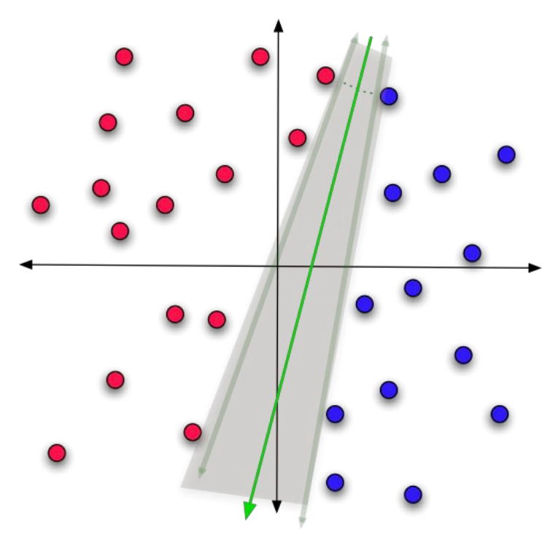
A less biased choice

Slide 34


Margin
the distance to closest point in the training data
We tend to get better generalization to unseen data if we choose the separating hyperplane which maximizes the margin

Slide 35
Support Vector Machines
A learning method which explicitly calculates the maximum margin hyperplane by solving a gigantic quadratic programming minimization problem.
Among the very highest -performing traditional machine learning techniques.
But it’s relatively slow and quite complicated.

Slide 36


Maximizing the Margin
x1
Select the
separating
hyperplane that
maximizes the
margin
Margin
Width
Margin
Width

Slide 37
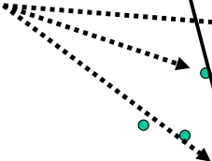
Support Vectors
x1
Support Vectors
Margin
Width

Slide 38
Support Vector Machines
A learning method which explicitly calculates the maximum margin hyperplane.

Slide 39
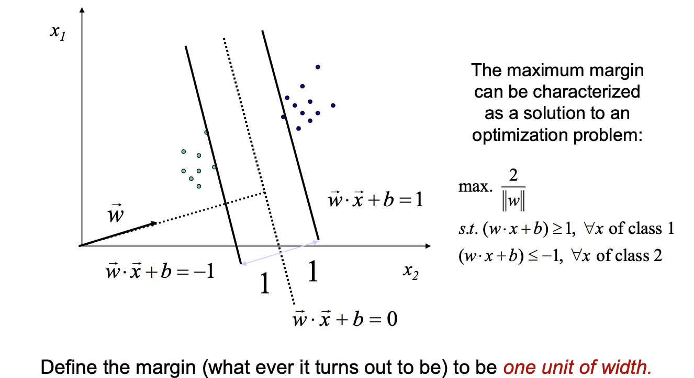
Setting Up the Optimization
Problem
Class1
Class 2

Slide 40
Setting Up the Optimization
Problem
Class1
Class 2

Slide 41
Setting Up the Optimization
Problem
Class1
Class 2

Slide 42
Setting Up the Optimization
Problem
Class1
Class 2

Slide 43
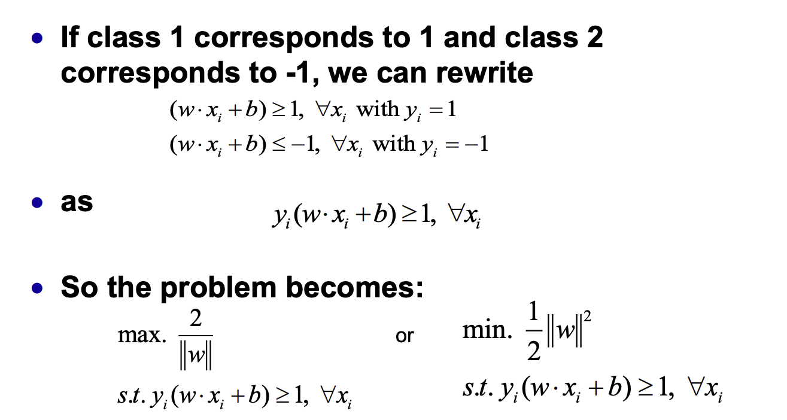
Setting Up the Optimization Problem

Slide 44
Setting Up the Optimization Problem

Slide 45
Setting Up the Optimization Problem

Slide 46
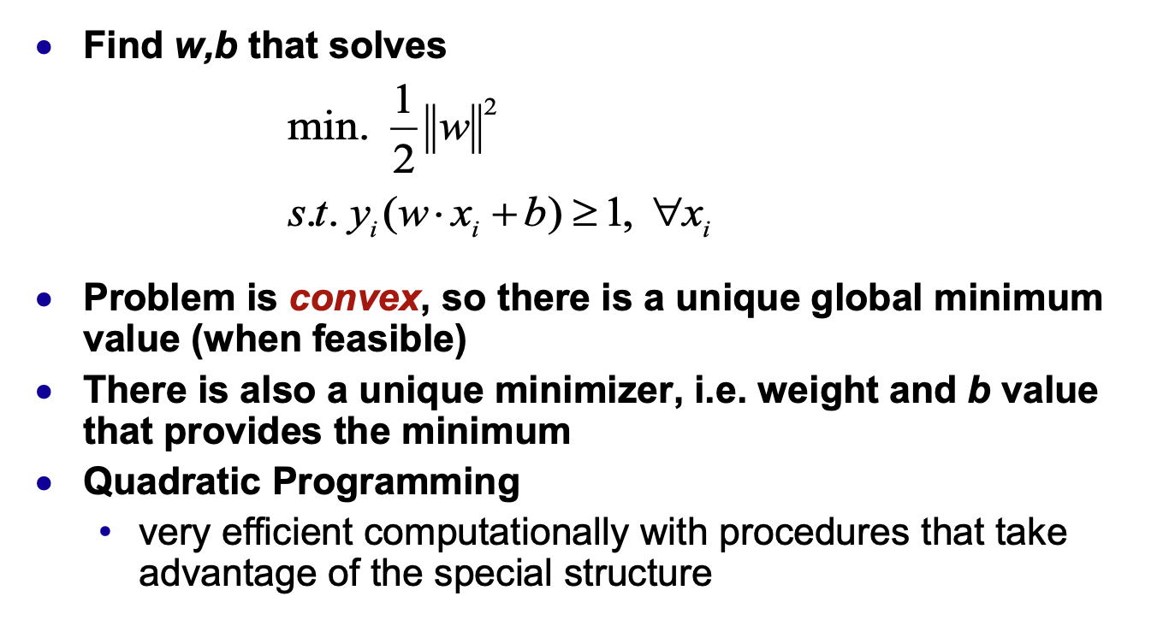
Linear, (Hard-Margin) SVM
Formulation

Slide 47
Linear, (Hard-Margin) SVM
Formulation

Slide 48
Linear, (Hard-Margin) SVM
Formulation

Slide 49
Linear, (Hard-Margin) SVM
Formulation

Slide 50
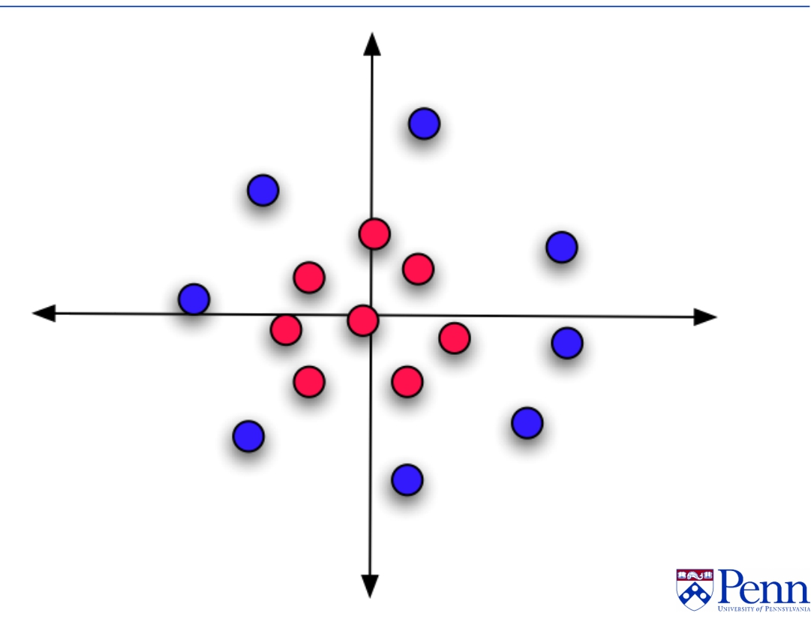
What if it isn’t separable?

Slide 51
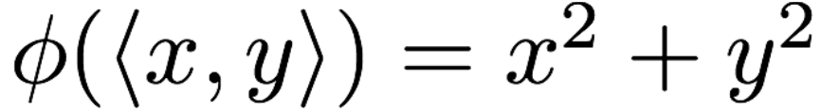
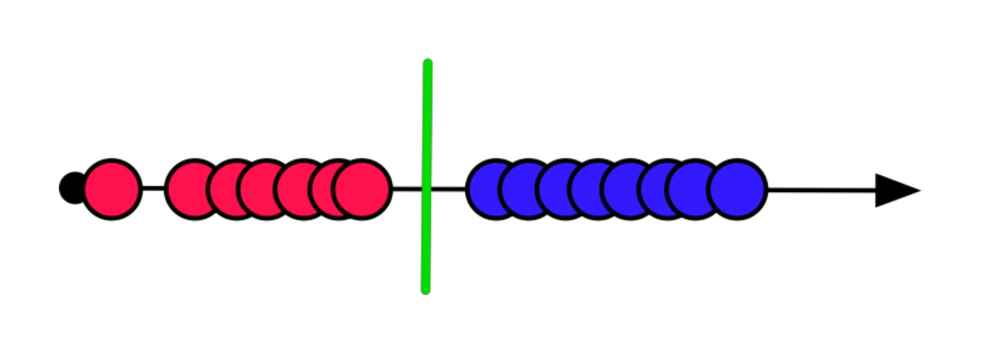
Project it to someplace where it is!

Slide 52
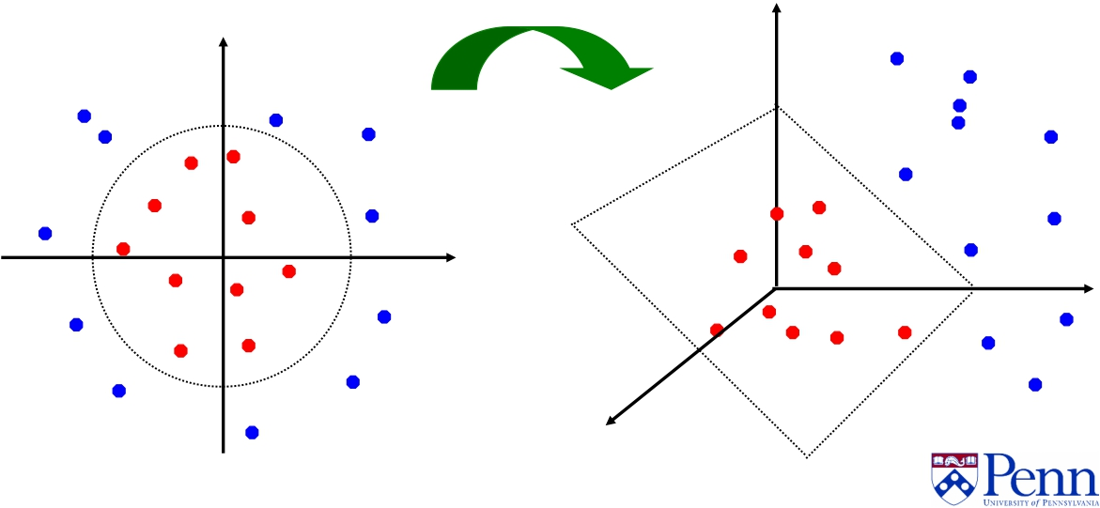
Sec. 15.2.3
Non - linear SVMs: Feature spaces
General idea: the original feature space can always be mapped to some higher - dimensional feature space where the training set is linearly separable:
Φ : x → φ ( x )

Slide 53
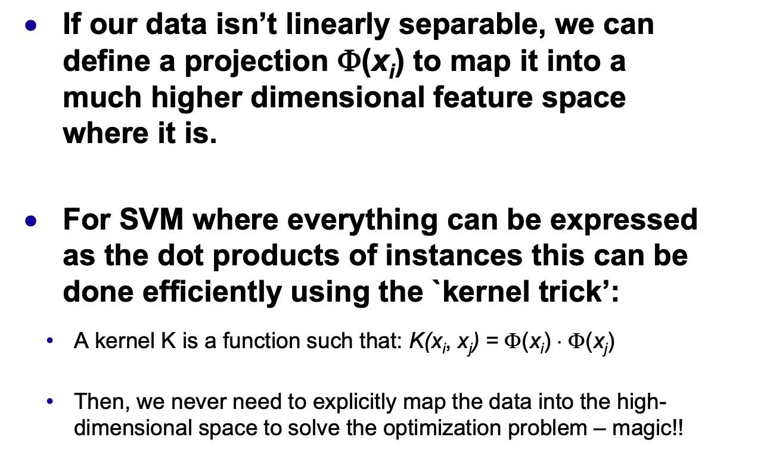
Kernel Trick

Slide 54
Kernel Trick

Slide 55
Kernel Trick

Slide 56
Kernel Trick

Slide 57
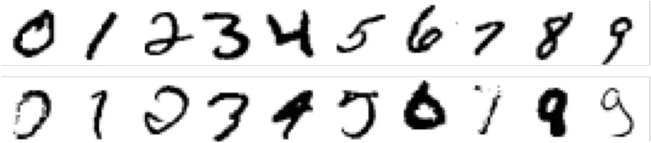
SVMs vs. other ML methods
Examples from the NIST database of handwritten digits
· 60K labeled digits 20x20 pixels 8bit greyscale values
·
Learning methods
· 3 -nearest neighbors
· Hidden layer neural net
· Specialized neural net ( LeNet)
· Boosted neural net
· SVM
· SVM with kernels on pairs of nearby pixels + specialized transforms
· Shape matching (vision technique)
· Human error: on similar US Post Office database 2.5%.

Slide 58
SVMs vs. other ML methods
Examples from the NIST database of handwritten digits
· 60K labeled digits 20x20 pixels 8bit greyscale values
·
Learning methods
· 3 -nearest neighbors
· Hidden layer neural net
· Specialized neural net ( LeNet)
· Boosted neural net
· SVM
· SVM with kernels on pairs of nearby pixels + specialized transforms
· Shape matching (vision technique)
· Human error: on similar US Post Office database 2.5%.

Slide 59
Performance on the NIST digit set (2003)
3 -NN
Hidden
Layer NN
LeNet
Boosted
LeNet
SVM
Kernel
SVM
Shape
Match
Error % 2.4 1.6 0.9 0.7 1.1 0.56 0.63
Run time
(millisec /digit)
1000
10
30
50
2000
200
Memory (MB) 12 .49 .012 .21 11
Training time
(days)
0
7
14
30
10
In 2010) (.35% error) by a neural network

Slide 60
Performance on the NIST digit set (2003)
3 -NN
Hidden
Layer NN
LeNet
Boosted
LeNet
SVM
Kernel
SVM
Shape
Match
Error % 2.4 1.6 0.9 0.7 1.1 0.56 0.63
Run time
(millisec /digit)
1000
10
30
50
2000
200
Memory (MB) 12 .49 .012 .21 11
Training time
(days)
0
7
14
30
10
In 2010) (.35% error) by a neural network

